Slide 1
Big-Five Personality Prediction of Movie Characters -- Experiment Process
Yung-Chun Chen, Sep. 2023

Slide 2
Unlabeled data
Unlabeled data
(structured)
Data cleansing
Data formatting
Start
Data collection
Labeled data
Data cleansing
Embedding
Training data
Data splitting
Model building
Parameter tuning
Model selection
Prediction
Testing data
Outcomes
Visualization
End

Slide 3
Data

Slide 4
Labeled Data
essays.csv (Pennebaker & King 1999)
2400 stream-of-consciousness texts labelled with personality
mypersonality_final.csv (Celli, Pianesi, Stillwell & Kosinski, 2013)
10000 Facebook status updates of 250 users labelled with personality (with scores)
Source: here
Questions: Which one performs better? Which one suits my unlabeled data?

Slide 5
Unlabeled Data
Internet Movie Database
Web crawler from GitHub
Scraping, parsing, formatting
@misc{Saha_Movie_Script_Database_2021, author = {Saha, Aveek}, month = {7}, title = {{Movie Script Database}}, url = {https://github.com/Aveek-Saha/Movie-Script-Database}, year = {2021} }

Slide 6
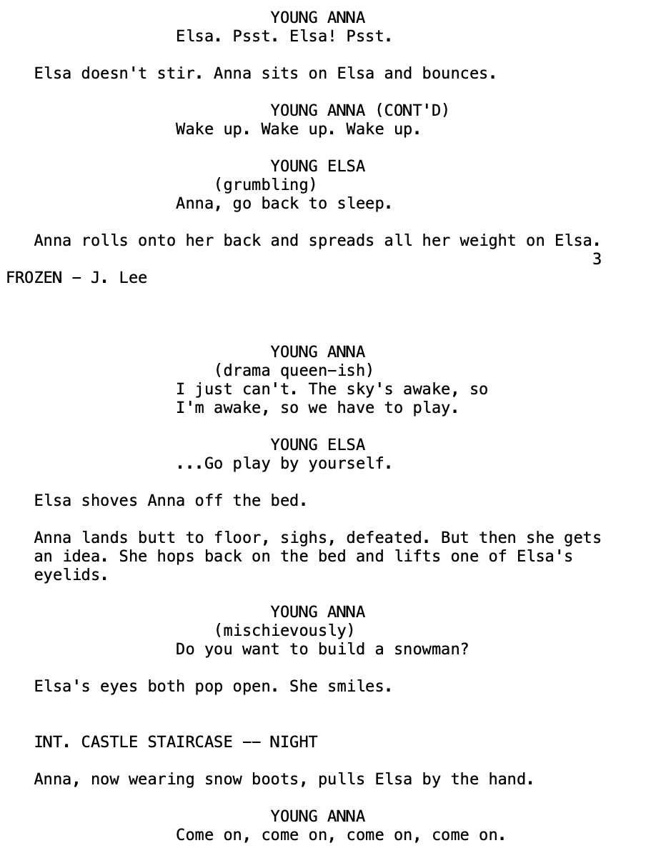
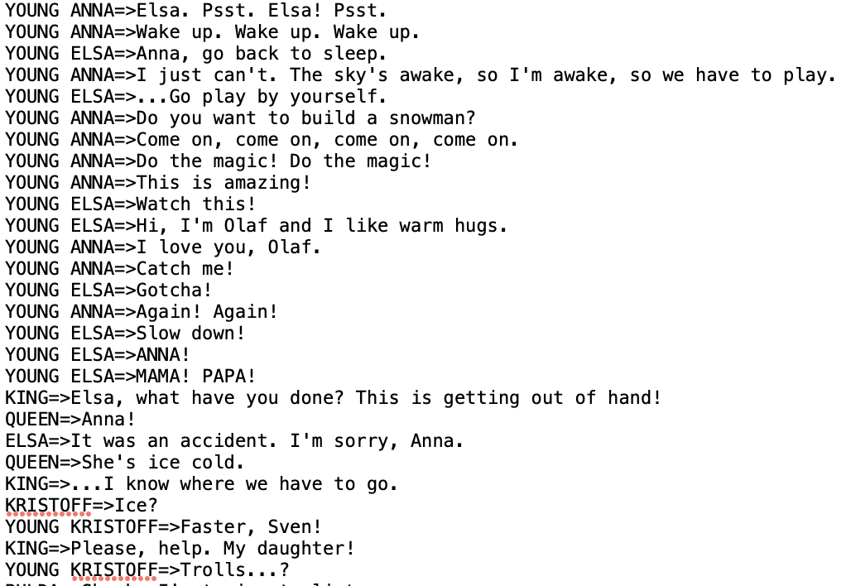

Slide 7
Data Cleansing

Slide 8
Text
Training & predicting data
Removed punctuations, numbers, non-sense words, stop words, and made them lower
Predicting data
Found main characters: characters whose number of lines exceeds the 95th percentile.
Applied text-embedding-ada-002 transforming model from OpenAI
Dropped files < 5mb

Slide 9
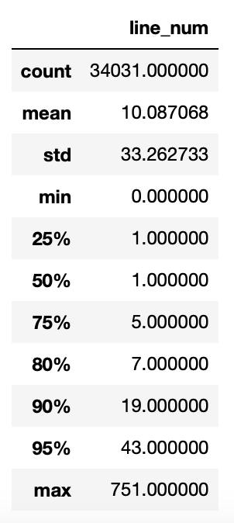
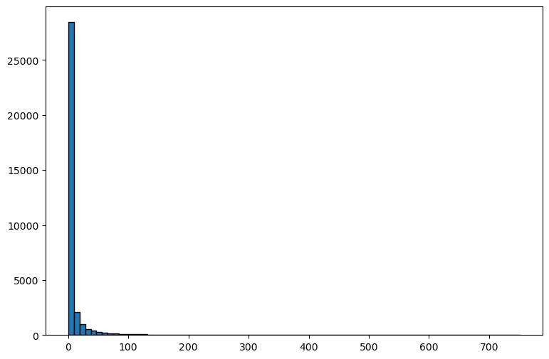
Distribution of lines

Slide 10
Model Selection

Slide 11
Model Comparison
Classification vs. regression
Random forest vs. SVM vs. Adaboost vs. MLPClassifier accuracy & overfitting
Different training datasets
Different methods of data cleansing
SVM parameters: linear vs. rbf vs. poly scale vs. auto
Gridsearch: find the best C
remove punctuations | remove stop words | rank
T | F | 2
T | T | 1
F | T | 4
F | F | 3

Slide 12
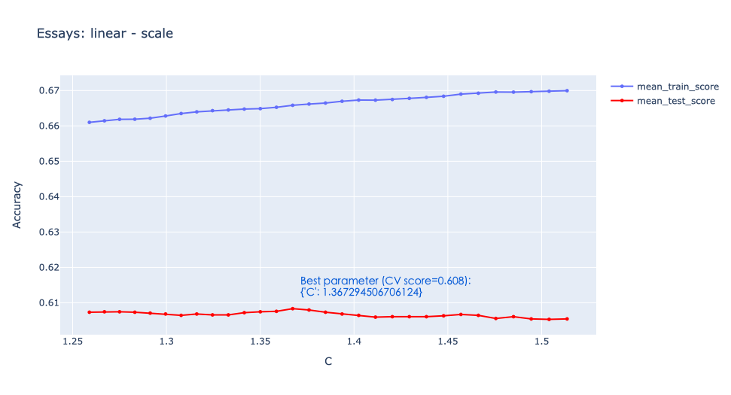
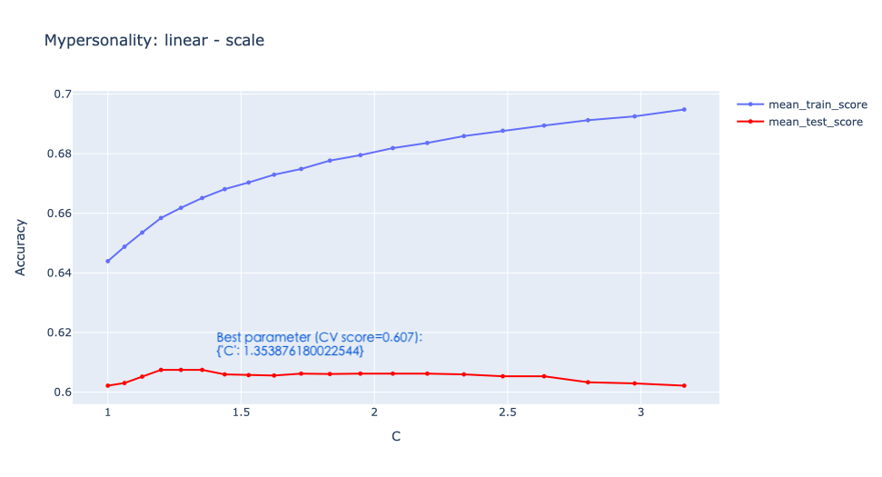
Different training datasets

Slide 13
The process is NOT linear

Slide 14
Unlabeled data
Unlabeled data
(structured)
Data cleansing
Data formatting
Start
Data collection
Labeled data
Data cleansing
Embedding
Training data
Data splitting
Model building
Parameter tuning
Model selection
Prediction
Testing data
Outcomes
Visualization
End

Slide 15
Further Improvement

Slide 16
Further Improvement
Data cleansing and structuring
Apply sentiment analysis for more features
Will the length of text affect?
Different models

